Slide 1
AI-based VR Conversation Demo
By TheVoice

Slide 2

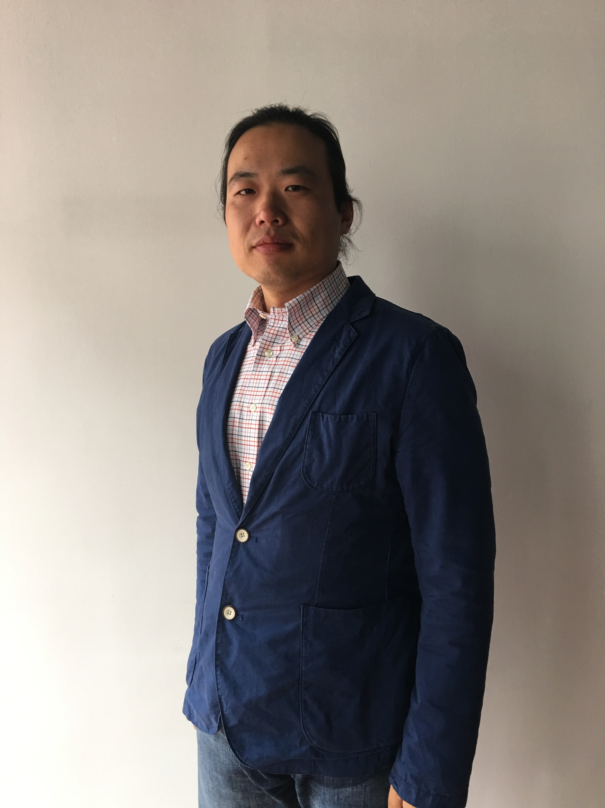
Team TheVoice
Shuo Pang
Korhan Akcura

Slide 3
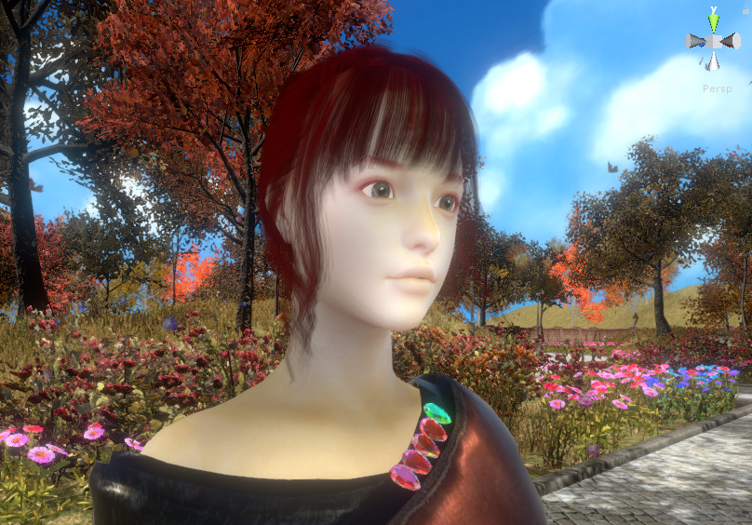
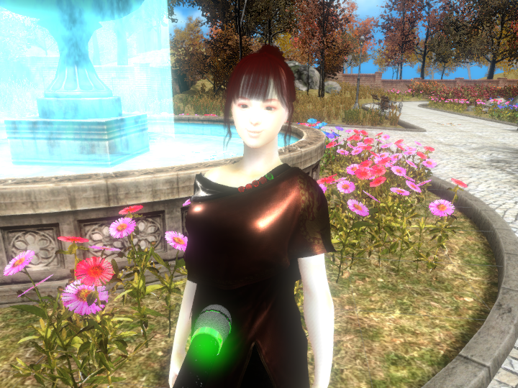
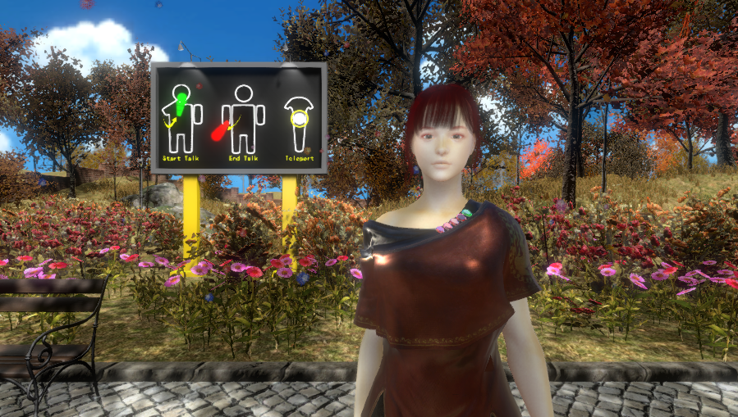
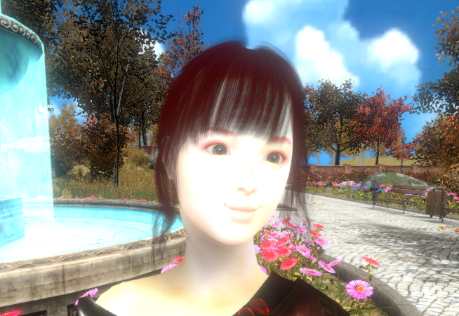
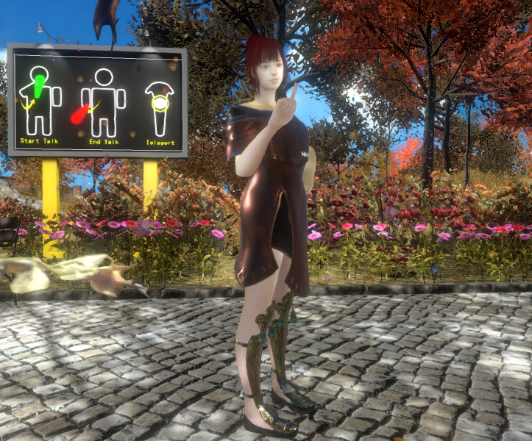
What’s the features?
AI-based Conversation Model
VR Immersive Experience
Natural Interaction
Emotion Analyzing
High Quality Rendering
Runtime Machine Learning

Slide 4
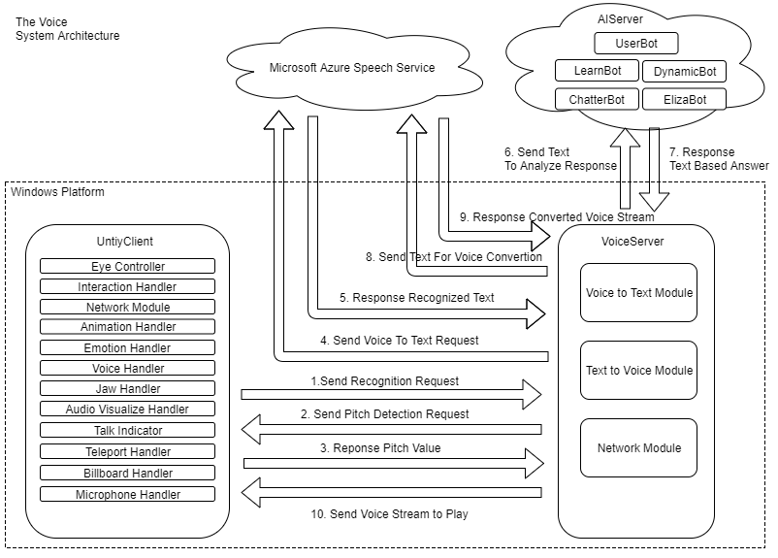

Slide 5
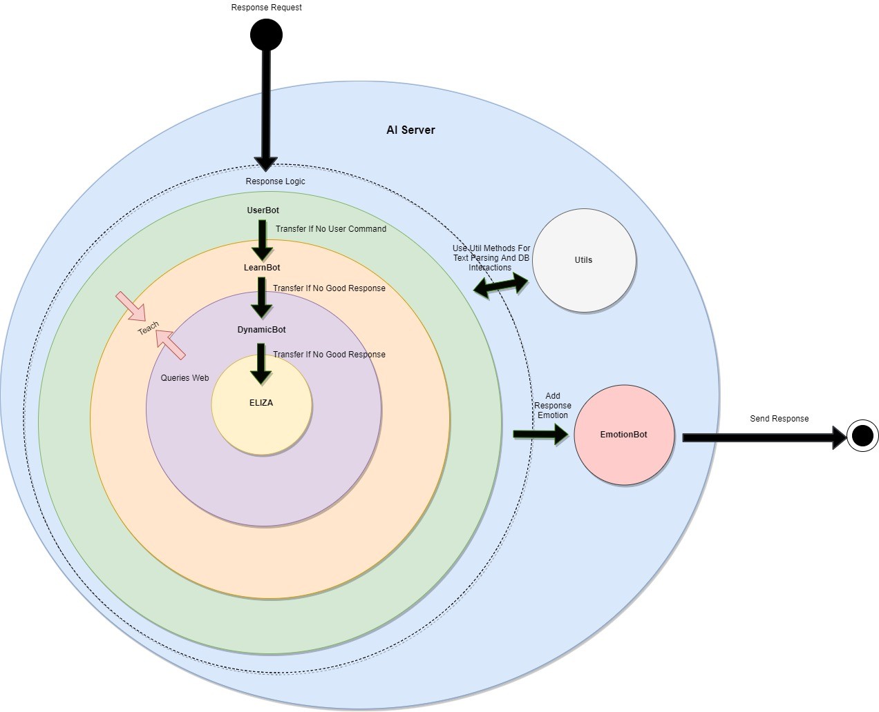

Slide 6
Thanks For Watching!
Contacts:
pangshuo1981@gmail.com
k_akcura@encs.concordia.ca

